Slide 1

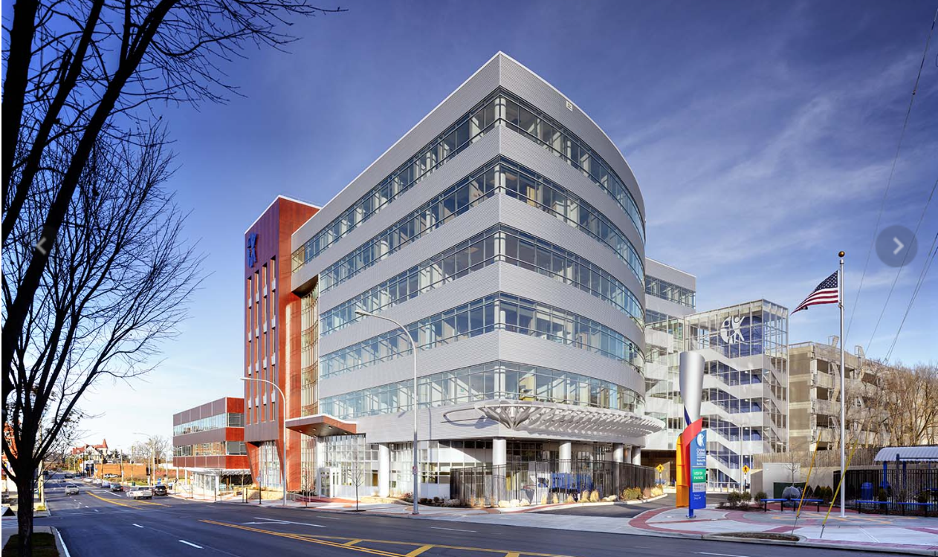
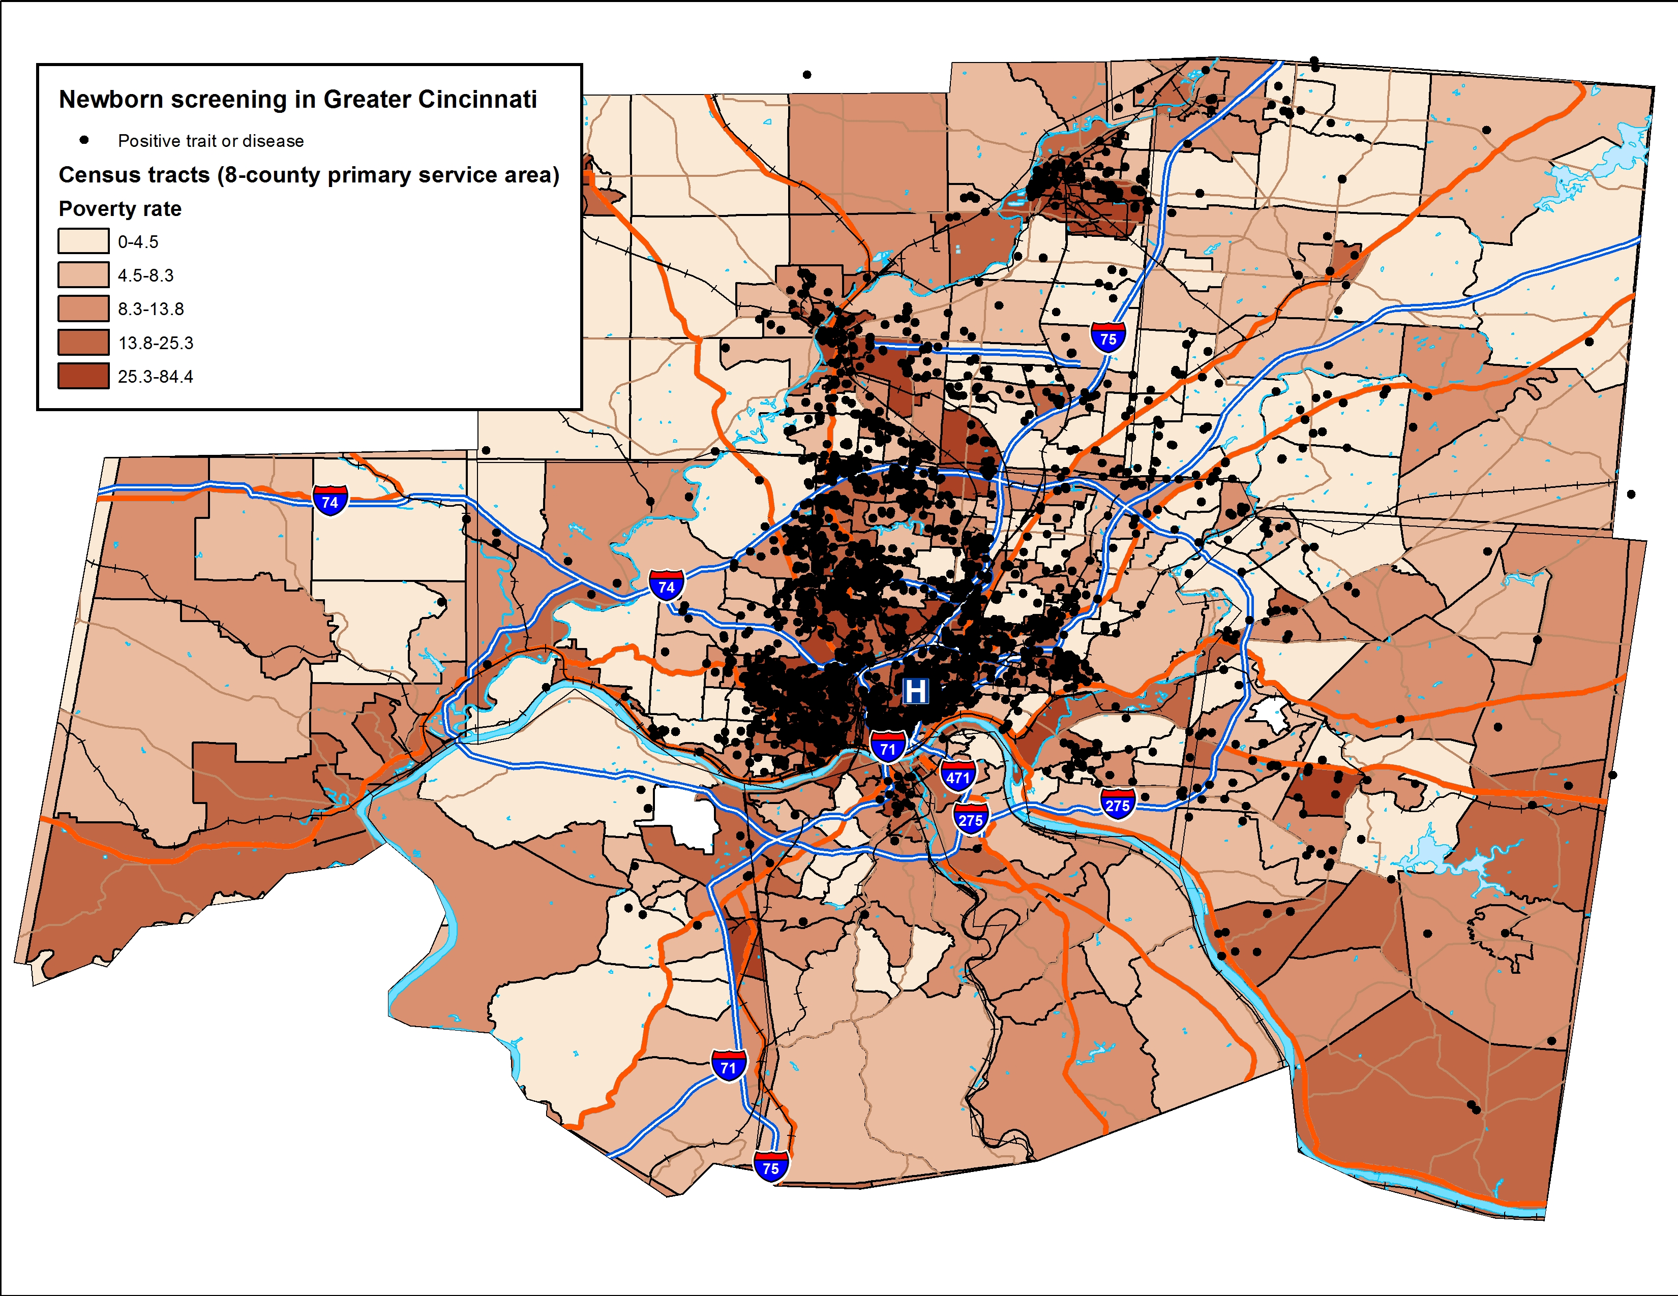
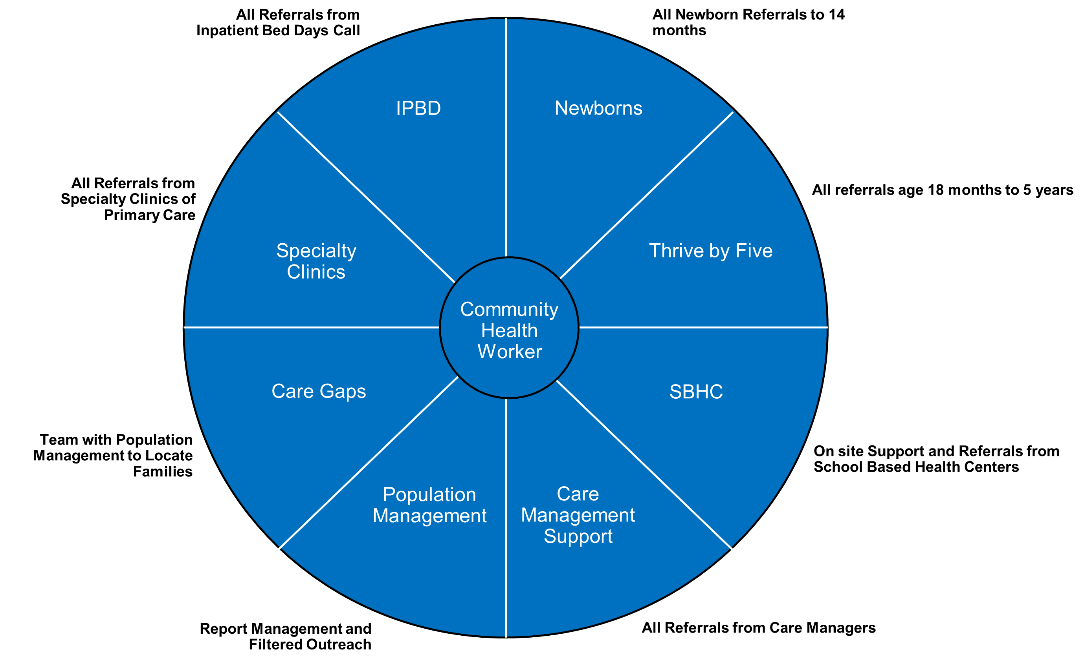
Improving Health Equity in Cincinnati’s Children
Cincinnati Children’s Hospital Medical Center- Pediatric Primary Care Center
Ronay Thomas, University of Cincinnati College of Medicine
About the Site
The Cincinnati Children’s Pediatric Primary Care Center is one of eight primary care sites staffed and managed by Cincinnati Children’s Hospital. These sites collectively serve nearly 40,000 children, the majority of whom (90%) are Medicaid recipients. The PPC provides primary care services including check-ups, vaccinations, and sick visits. However, because of the social, economic, and environmental barriers the patient population faces, the PPC also provides many additional services to meet these needs. Along with the patient care team, the PPC also employs social workers, community health workers, and Legal Aid representatives who work tirelessly to ensure that each patient receives the help that they need both inside and outside of the the doctor’s office.
Project Proposals
Community Health Worker Program
The patient population seen at the PPC is one that faces many barriers to healthcare which ultimately lead to increased healthcare utilization and poorer health outcomes. A large part of the effort to reengage these patients and help mediate some of the barriers that they face has been the utilization of community health workers in clinic. Community Health Workers help bridge the gap between families and the healthcare team by accompanying patients to appointments, reengaging patients that have been lost to follow-up, managing specialty care, advocating for patient and community needs, assisting in patient education, and fostering patient self-advocacy. Our goal was to capture the totality of the community health worker program implemented at each of CCHMC’s 8 primary care centers
Sickle Cell Patient Neighborhood vs Outcome
Although this project is only in its very early stages, our goal was to utilize census tracks to identify any correlation between health outcomes like ED visits, hospitalizations, and HbF in pediatric Sickle Cell patients and the neighborhoods where these patients live. Previous studies have shown increased healthcare utilization among patients living in some of Cincinnati’s most impoverished neighborhoods including Avondale, Price Hill and OTR. We hope to localize these patients to specific neighborhoods in order to focus additional interventions in areas with the greatest need.
Newborn Sickle Cell Screen Neighborhood Mapping
Because each newborn is screened for Sickle Cell Disease and Sickle Cell trait immediately after birth, we were able to use this information to locate clusters of affected patients. We started by obtaining and reformatting the list of sickle cell patients seen at Cincinnati Children’s. We mapped each patient to a neighborhood using Hamilton County census tracts, then created a visual map showing where patients with Sickle Cell Disease and Sickle Cell trait clustered. The results of this project have larger population implications and could potentially be used to deliver needed community resources and educational materials to Sickle Cell patients
Conclusions and Future Steps
These projects provided new insights into the needs and experiences of the patients seen at Cincinnati Children’s. One common thread in each of the projects mentioned is the identification and mediation of significant health barriers in Cincinnati’s most disadvantaged neighborhoods. Although there have been amazing strides made to provide equitable care to all of Cincinnati's children, there is definitely more work to be done.
Special Thanks.
Special Thanks to all of the staff at the Cincinnati Children’s pediatric primary care center and the department of General and community pediatrics. I would also like to thank Dr. Andy Beck who served as my site coordinator and mentor throughout this amazing experience!
.
My Summer Experience
Throughout my internship, I had the wonderful experience of observing the many different aspects of community pediatrics in action. From shadowing in the PPC to attending meetings between healthcare providers and community leaders, each experience offered a new perspective on patient care beyond the hospital.
There was no such thing as a typical day during my time at the PPC. While I typically worked on producing a Community Health Worker manuscript each day, I also attended meetings and events with community partners like the Caring Families in Avondale and Rising Strong in Price Hill and health equity meetings with the community pediatrics team. Finally, I spent time shadowing physicians at the PPC, hematology clinic, and Oncology clinic, each of which gave me a unique perspective on patient care.

